Slide 1
Areas of Assessment
Livelihood zones
Framework

Slide 2
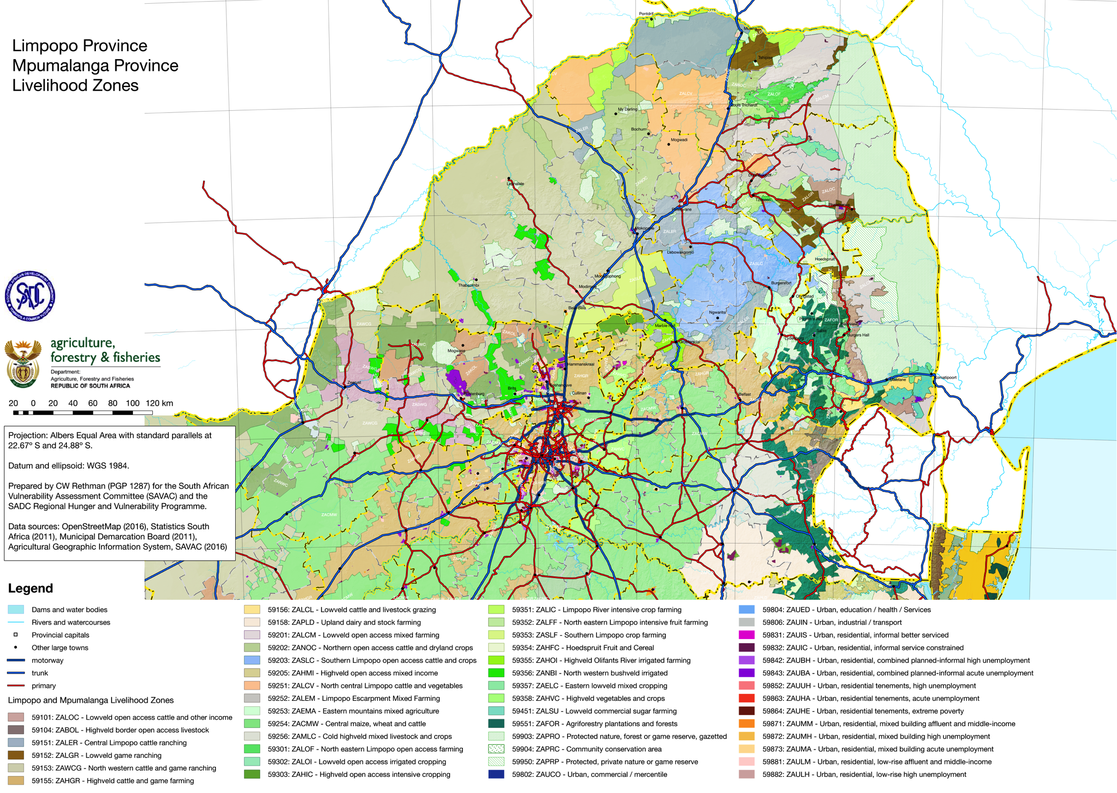

Slide 3
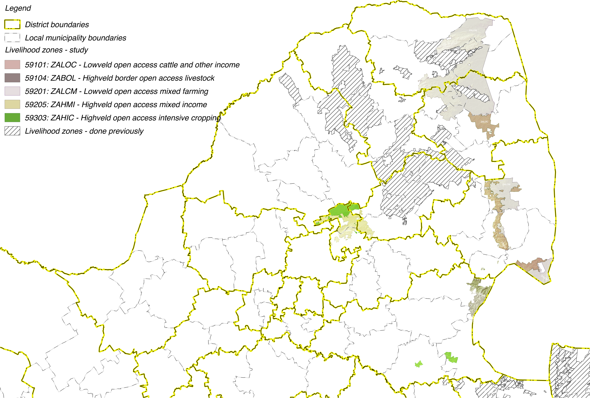

Slide 4
Livelihoods Findings:
Wealth Descriptions and Wealth Breakdowns

Slide 5
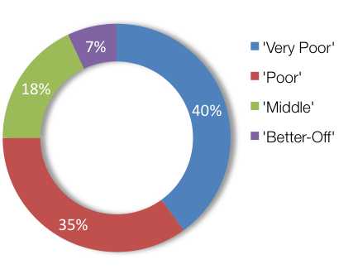
Wealth Breakdowns & Descriptions: ZALCM – Lowveld Open Access Mixed Farming (59201)
WEALTH GROUP | LIVESTOCK (cattle) | FARM SIZE (ha) | MAIN INCOME | ANNUAL INCOME
Very Poor | 0 – 7 [4] | 1.0 | Grants | 302,300
Poor | 3 – 10 [5] | 1.5 | Grants | 179,300
Middle | 10 – 50 [20] | 2.0 | Employ | 52,300
Better Off | 15 – 200 [50] | 2.0 | Employ/agric | 34,000
Notes:
Remember to mention that HOUSEHOLD SIZES vary and thus incomes per capita can be quite different from the Hh incomes reported here.
DON’T CLICK TOO FAST THROUGH THE ANIMATIONS!!

Slide 6
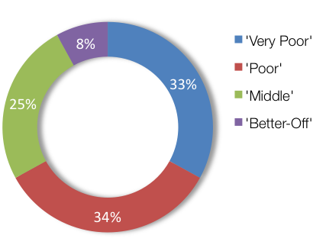
Wealth Breakdowns & Descriptions: ZAHIC – Highveld Open Access Intensive Cropping (59303)
WEALTH GROUP | LIVESTOCK (cattle) | FARM SIZE (ha) | MAIN INCOME | ANNUAL INCOME
Very Poor | 0 | 0.75 | Grants | 348,200
Poor | 0 – 4 [2] | 1.0 | Grants | 96,600
Middle | 0 – 15 [10] | 1.2 | Employ | 70,500
Better Off | 5 – 60 [30] | 2.0 | Employ/agric | 37,700
Notes:
DON’T CLICK TOO FAST THROUGH THE ANIMATIONS!!

Slide 7
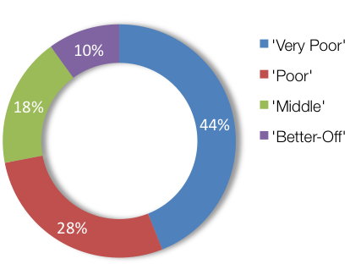
Wealth Breakdowns & Descriptions: ZABOL – Highveld border open access livestock (59104)
WEALTH GROUP | LIVESTOCK (cattle) | FARM SIZE (ha) | MAIN INCOME | ANNUAL INCOME
Very Poor | 0 | 0.25 | Grants | 309,500
Poor | 0 – 4 [3] | 0.5 | Grants | 117,900
Middle | 5 – 13 [10] | 1.0 | Employ | 48,100
Better Off | 10 – 25 [20] | 2.0 | Employ | 27,300
Notes:
DON’T CLICK TOO FAST THROUGH THE ANIMATIONS!!

Slide 8
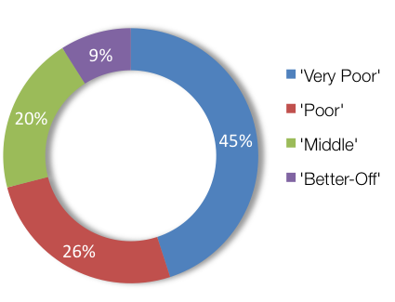
Wealth Breakdowns & Descriptions: ZALOC – Lowveld Open Access Cattle and Other Income (59101)
WEALTH GROUP | LIVESTOCK (cattle) | FARM SIZE (ha) | MAIN INCOME | ANNUAL INCOME
Very Poor | 0 | 0.2 | Grants | 348,200
Poor | 0 – 4 [2] | 0.3 | Grants | 96,600
Middle | 0 – 15 [10] | 0.3 | Employ | 70,500
Better Off | 5 – 60 [30] | 4.0 | Employ | 37,700
Notes:
DON’T CLICK TOO FAST THROUGH THE ANIMATIONS!!

Slide 9
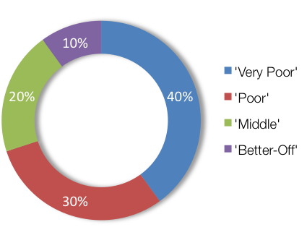
Wealth Breakdowns & Descriptions: ZAHMI – Highveld Open Access Mixed Income (59205)
WEALTH GROUP | LIVESTOCK (cattle) | FARM SIZE (ha) | MAIN INCOME | ANNUAL INCOME
Very Poor | 0 | 0.5 | Grants | 211,700
Poor | 0 – 7 [3] | 0.5 | Grants | 133,200
Middle | 6 – 10 [8] | 0.5 | Employ | 61,500
Better Off | 10 – 20 [15] | 0.5 | Employ | 44,800
Notes:
DON’T CLICK TOO FAST THROUGH THE ANIMATIONS!!

Slide 10
Livelihoods Findings:
Sources of Food and Income

Slide 11
Consumption & Reference Year
Concept of Consumption Year:
Annual period beginning at the start of the main harvest and ending just before the next main harvest;
Usually April to following March… except in ZALOC and ZALCM: May to following April.
Reference Year:
Year to which these baselines apply: needs to be fairly recent, typical (occurs frequently), not a bad year (e.g. 2015/2016) nor a good year;
2013 to 2014 chosen by villagers, i.e. April 2013 to March 2014 (except in ZALOC, ZALCM: May 2013 to Apr 2014).

Slide 12
Seasonality
Activity | Who? | Apr | May | Jun | Jul | Aug | Sep | Oct | Nov | Dec | Jan | Feb | Mar
Maize, LP | Both
P | Both
W | Both
GH | Female
DH | Both
S’flower LP | Male
P
W | Both
H | Male
Beans LP | Both
P | Both
W | Both
H | Both
Vegetables | Female
Cas lab Crop | Both
Dom | Female
Herd | Male
Pub | Both
Off-farm employ | Both
L’stock (heat/birth)
L’stock sales | Male
Labour Migration | Both
Purchases Low P
High P
Annual hunger | Both
Health ‘flu
Health diahhreoa
Notes:
Show the cropping seasons for each major crop
Distribution and spread of other activities throughout the year

Slide 13
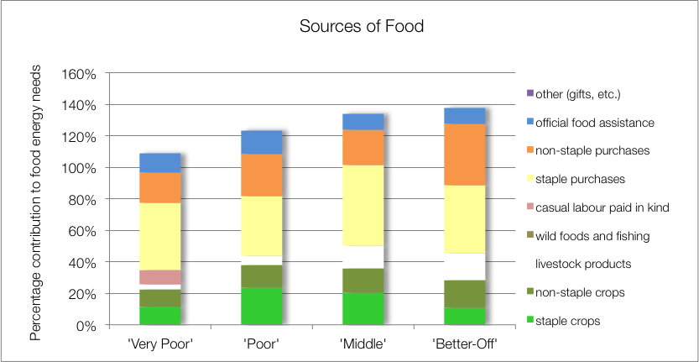
Source of Food: ZALCM – Lowveld Open Access Mixed Farming (59201)
Key findings:
Crops (maize, beans, w.melon, gnuts, roundnuts & pumpkin) important (~23% to 38%)
Food purchase (>50%)
School feeding to all WGS (~10% to 15%)
Notes:
DON’T CLICK TOO FAST THROUGH THE ANIMATIONS!!

Slide 14
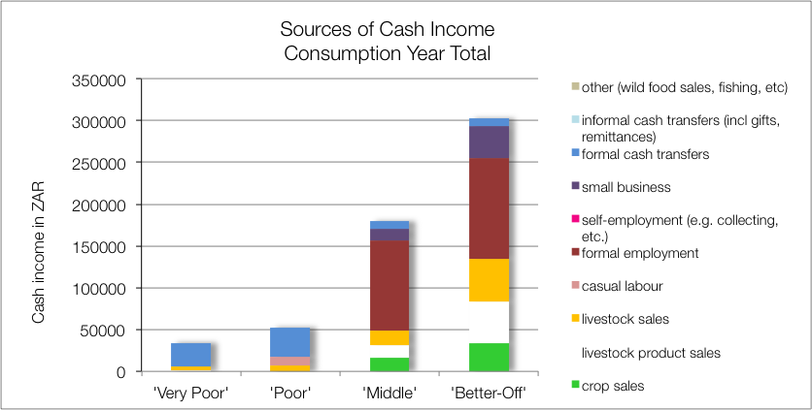
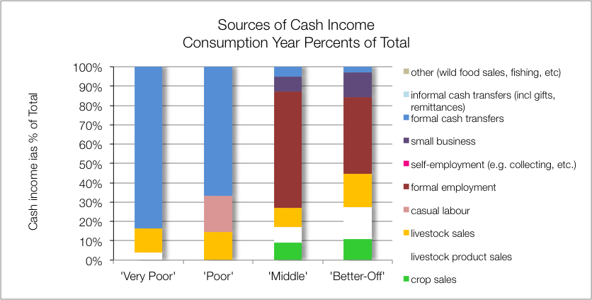
Source of Cash: ZALCM – Lowveld Open Access Mixed Farming (59201)
Key findings:
Agriculture (crops and livestock) income high (up to 45%)
Formal employemnt, M (60%) & BO (40%)
Grants VP (84%) & P (67%)
Casual labour P (19%)
Notes:
DON’T CLICK TOO FAST THROUGH THE ANIMATIONS!!
Explain the difference between the two graphs: the upper is the absolute values (in Rands) and the lower is proportions of totals (in %).

Slide 15
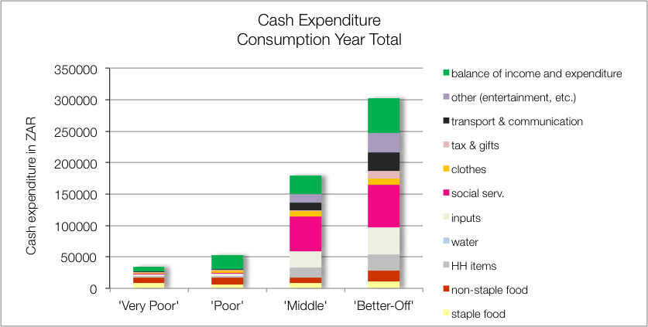
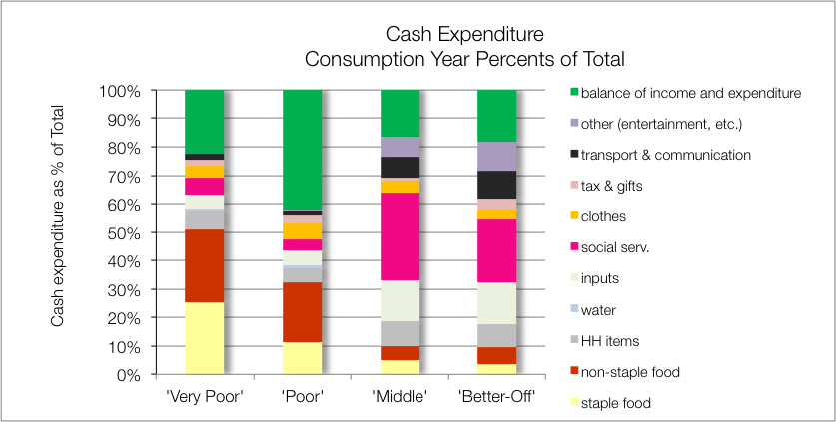
Source of Cash: ZALCM – Lowveld Open Access Mixed Farming (59201)
Key findings:
Soc Services (school, health), M (30%) & BO (22%)
Inputs (incl labour), M & BO (~15%)
Food, VP (>50%) & P (>30%)
Notes:
DON’T CLICK TOO FAST THROUGH THE ANIMATIONS!!

Slide 16
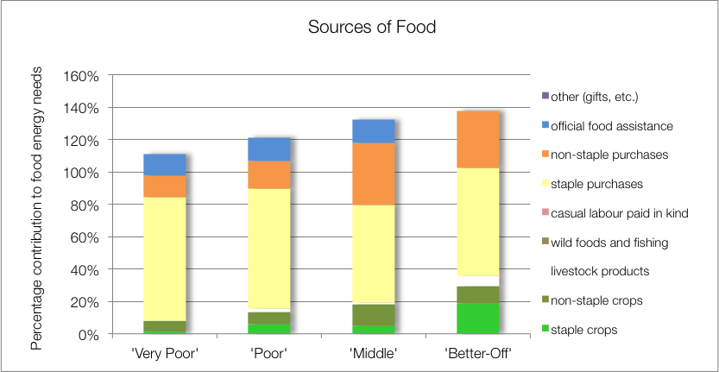
Sources of Food: ZAHIC – Highveld Open Access Intensive Cropping (59303)
Key findings:
Crops (maize, beans, w.melon & pumpkin) important, M (18%) & BO (29%)
Food purchase (>90%)
School feeding to VP, P & M (BO at fee school) (~14%)
Notes:
DON’T CLICK TOO FAST THROUGH THE ANIMATIONS!!

Slide 17
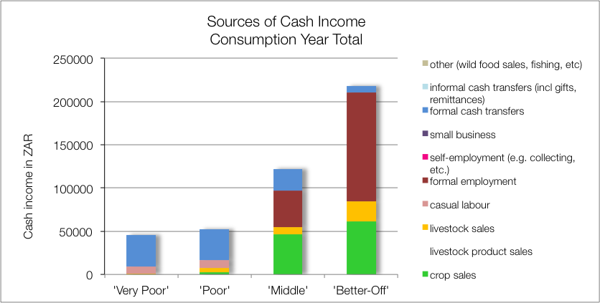
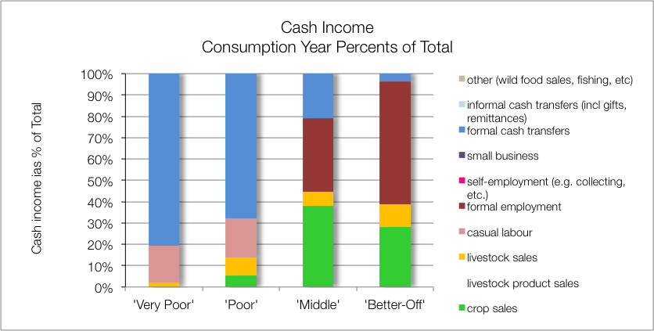
Sources of Cash: ZAHIC – Highveld Open Access Intensive Cropping (59303)
Key findings:
Agriculture—crop (cotton & sunflower) and livestock sales high for M (45%) & BO (38%)
Formal employemnt M (35%) & BO (58%)
Grants VP (81%) & P (68%)
Casual labour VP & P (~18%)
Notes:
DON’T CLICK TOO FAST THROUGH THE ANIMATIONS!!

Slide 18
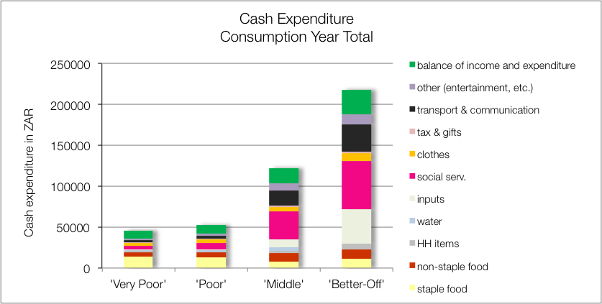
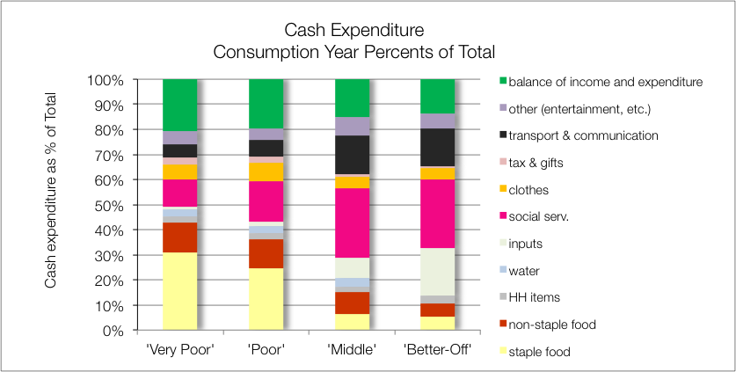
Sources of Cash: ZAHIC – Highveld Open Access Intensive Cropping (59303)
Key findings:
Soc Services (school, health), M & BO (~28%)
Inputs (incl labour), M (10%) & BO (19%)
Food, VP (>40%) & P (>30%)
Notes:
DON’T CLICK TOO FAST THROUGH THE ANIMATIONS!!

Slide 19
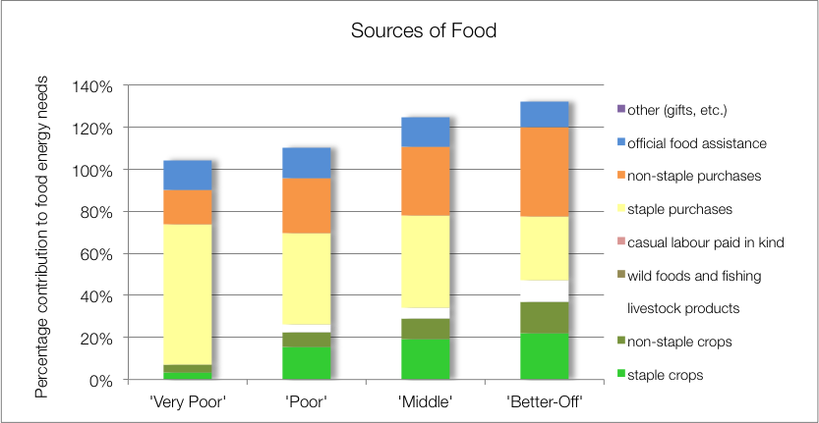
Sources of Food: ZABOL – Highveld border open access livestock (59104)
Key findings:
Crops (maize, gr maize, cabbage, beans, s.potatoes, gnuts, spinach) important to P, M & BO (22% to 37%)
Food purchase (>70%)
School feeding to all WGS (~14%)
Notes:
DON’T CLICK TOO FAST THROUGH THE ANIMATIONS!!

Slide 20
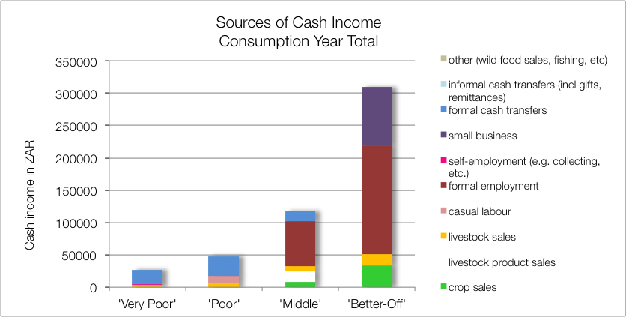
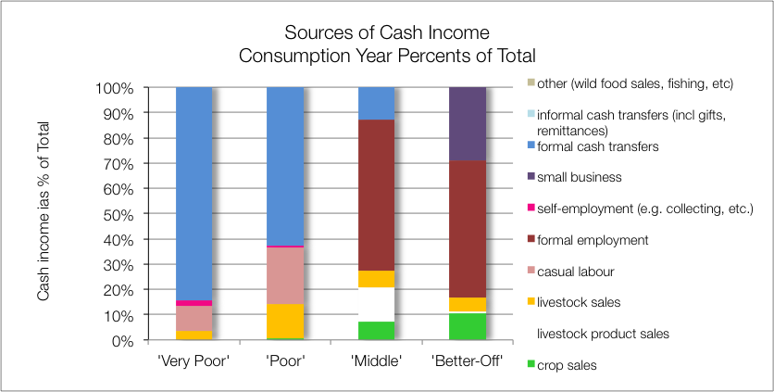
Sources of Cash: ZABOL – Highveld border open access livestock (59104)
Key findings:
Agriculture (crops and livestock) income: M (20%) & BO (11%)
Formal employemnt: M (60%) & BO (55%)
Small business: BO (29%)
Grants, VP (84%) & P (63%)
Casual Labour, VP (10%) & P (22%)
Notes:
DON’T CLICK TOO FAST THROUGH THE ANIMATIONS!!

Slide 21
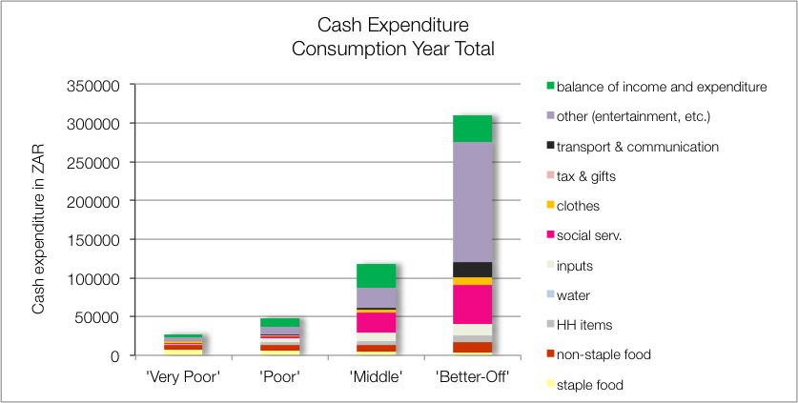
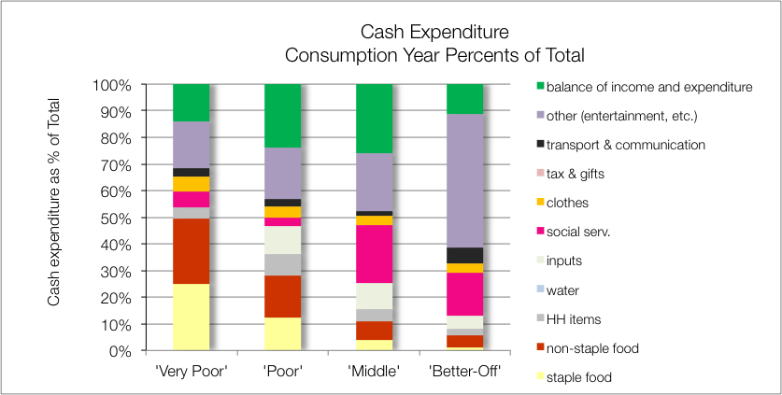
Sources of Cash: ZABOL – Highveld border open access livestock (59104)
Key findings:
Soc services (school & health), M (24%) & BO (19%)
Food, VP (50%) & P (30%)
Other (entertainment, etc.): VP, P & M (17% to 22%); BO (47%)
Notes:
DON’T CLICK TOO FAST THROUGH THE ANIMATIONS!!

Slide 22
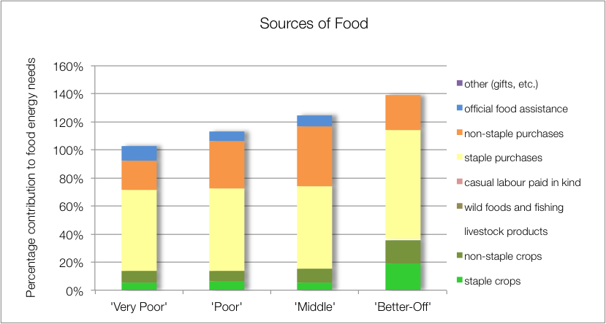
Sources of Food: ZALOC – Lowveld Open Access Cattle and Other Income (59101)
Key findings:
Crops (maize & gnuts) signifiant for BO only (36%)
Food purchase (>79%)
School feeding to VP, P & M (BO at fee school) (~9%)
Notes:
DON’T CLICK TOO FAST THROUGH THE ANIMATIONS!!

Slide 23
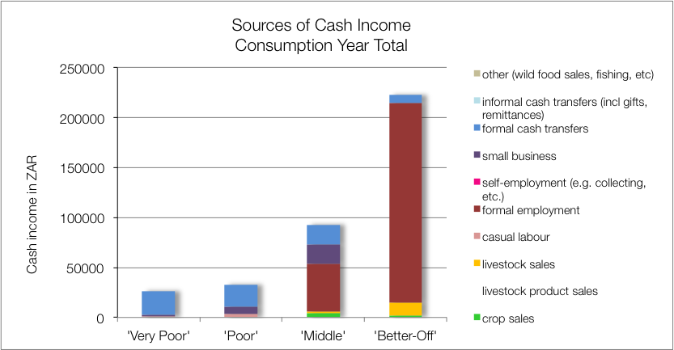
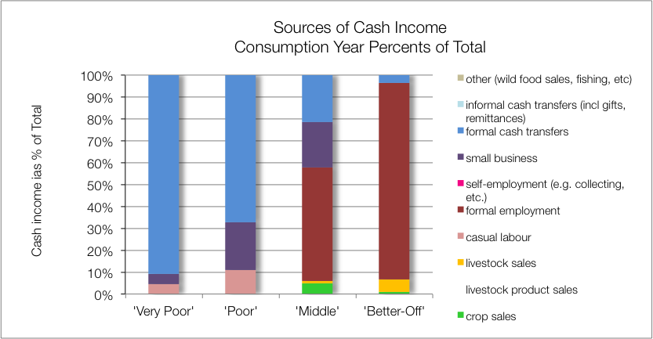
Sources of Cash: ZALOC – Lowveld Open Access Cattle and Other Income (59101)
Key findings:
Formal employemnt M (52%) & BO (90%)
Petty trading P & M, (~21%)
Grants, VP (91%) & P (67%)
Casual labour, P (11%)
Notes:
DON’T CLICK TOO FAST THROUGH THE ANIMATIONS!!

Slide 24
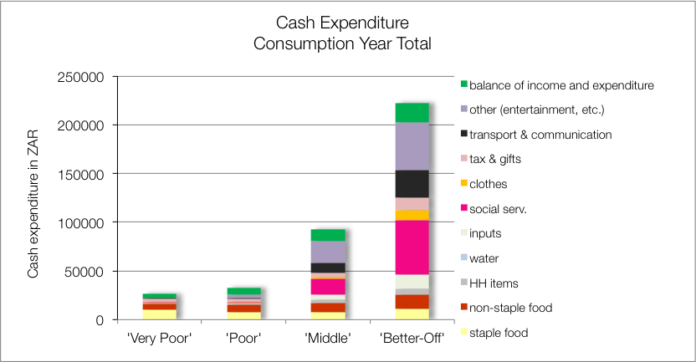
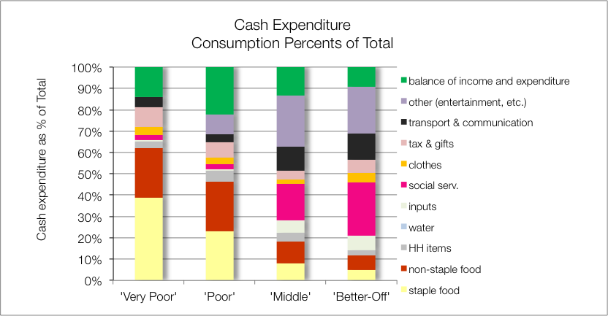
Sources of Cash: ZALOC – Lowveld Open Access Cattle and Other Income (59101)
Key findings:
Soc services (school & health), M (20%) & BO (25%)
Food, VP (60%) & P (45%)
Other (entertainment, etc.): M & BO (~22%)
Notes:
DON’T CLICK TOO FAST THROUGH THE ANIMATIONS!!

Slide 25
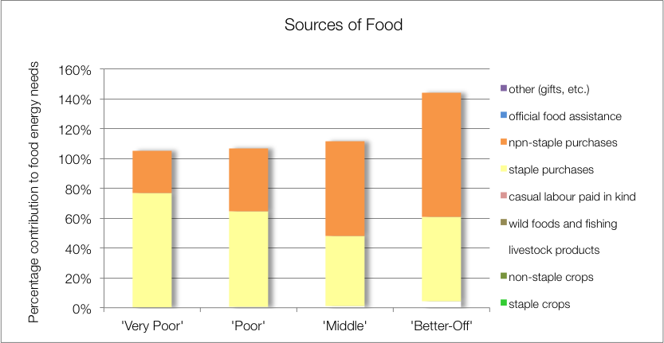
Sources of Food: ZAHMI – Highveld Open Access Mixed Income (59205)
Key findings:
Food purchases the only source of food, (>100%)
No crops, social support, other sources
Households vulnerable to market shocks
Notes:
DON’T CLICK TOO FAST THROUGH THE ANIMATIONS!!

Slide 26
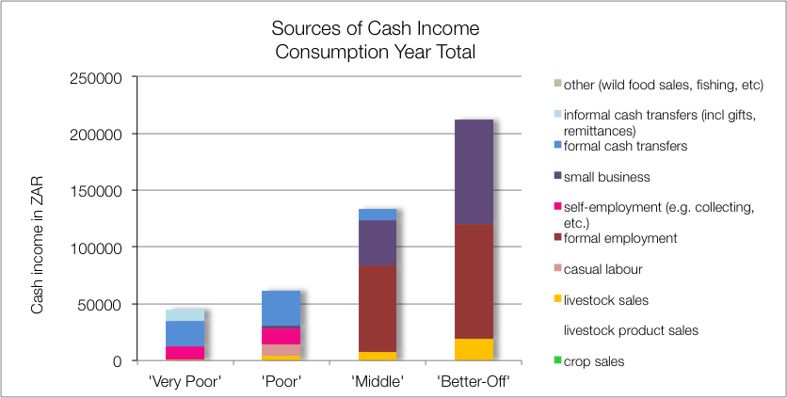
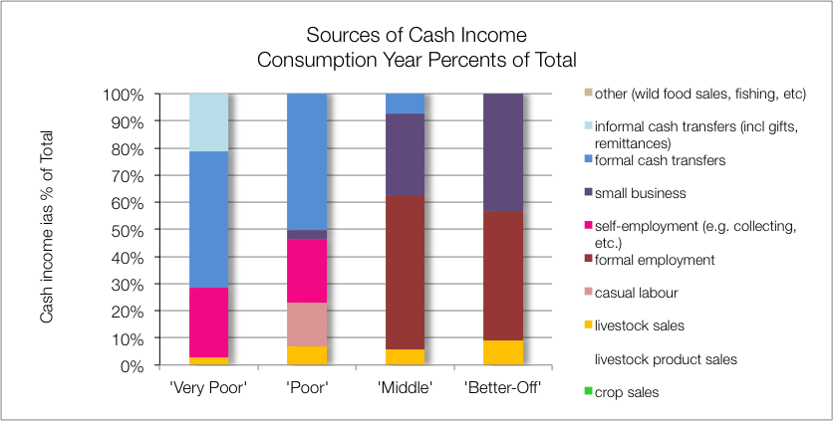
Sources of Cash: ZAHMI – Highveld Open Access Mixed Income (59205)
Key findings:
Formal employment M (57%) & BO (48%)
Small business M (30%) & BO (43%)
Grants VP & P (~50%)
Self-employment VP & P (~25%)
Remittances VP (21%)
Notes:
DON’T CLICK TOO FAST THROUGH THE ANIMATIONS!!

Slide 27
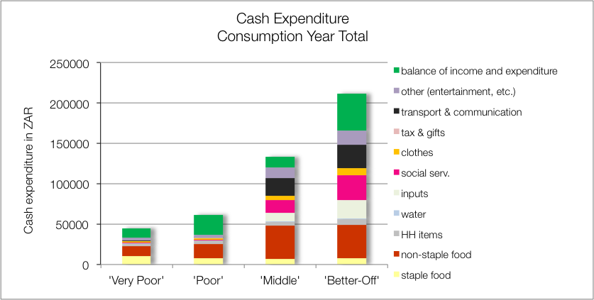
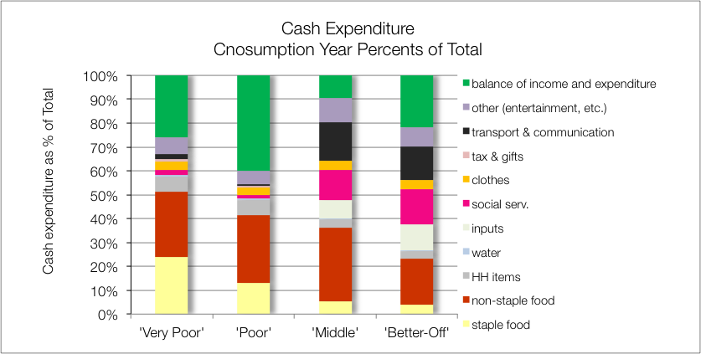
Sources of Cash: ZAHMI – Highveld Open Access Mixed Income (59205)
Key findings:
Transport, M & BO (~15%)
Soc Services (school, health), M (12%) & BO (15%)
Food, VP (>50%), P( >40%) & M (>35%)
Notes:
DON’T CLICK TOO FAST THROUGH THE ANIMATIONS!!

Slide 28
Summary of all Five Livelihood Zones
Most Hh’s depend at least 50% on purchases for food
Expenditure on food for ‘Very poor’ & ‘Poor’: ~50% and ~30% respectively
Formal employment usually what defines the wealthy
- can add to crop & livestock production (ZALCM & ZAHIC)
- can be augmented by a small business (ZAHMI)
Social grants make up 50%-90% of income for ‘Very Poor’ and ‘Poor’

Slide 29
THE END

